Slide 1
HAND GESTURE RECOGNITION

Slide 2
TEAM MEMBERS
T.HARSHA VARDHAN
T.SAKETH
T.SHANTAN
U.SASI KUMAR
99210041292
9921004706
9921004711
99210041646

Slide 3
ABSTRACT
The process of hand gesture recognition involves capturing the movement and position of the hand and fingers using cameras .
Hand gesture recognision helps to detect the alphabet according to the symbols that we show by our hand.
After running the program ,camera of our system is switched on and if we place our hand infront of camera it captures the movement and symbol of our hand and displays the respective alphabet.
The result will be keep on changing until the movement of hand is stopped.
We used CNN(Convolutional Neural Network) as algorithm from teachable machine.
Teachable machines train the data with CNN and provides model and then model is imported into the code.

Slide 4
INTRODUCTION
Hand gesture recognition is a field of computer science that deals with the interpretation and understanding of hand movements and postures.
It involves using computer vision and machine learning techniques to recognize and classify different hand gestures in real-time.
Hand gesture recognition has various applications in fields such as human-computer interaction, gaming, virtual and augmented reality, robotics, and sign language recognition.
In human-computer interaction, hand gesture recognition can provide natural way of interacting with computers.
Overall, hand gesture recognition is an exciting and rapidly evolving field that has the potential to transform the way we interact with technology and the world around us.

Slide 5
LITERATURE SURVEY
Title:Real-time hand gesture recognition using neural networks.
Author:Arun Ross and Ram Nevatia
Description: This paper proposes a real-time hand gesture recognition system using neural networks. The system uses a combination of edge detection and contour analysis to extract hand features and then classifies them using a feedforward neural network.

Slide 6
SURVEY-2
Title:Hand gesture recognition using machine learning
Author:A. M. A. Bhuiyan and M. A. Hossain
Description:This paper provides a review of hand gesture recognition methods that use machine learning techniques. The authors cover various approaches, including decision trees, support vector machines, and deep learning methods.

Slide 7
SURVEY-3
Title:A survey of vision-based hand gesture recognition.
Author:Gokul Varadharaj and Balasubramanian Raman.
Description:This paper provides a survey of vision-based hand gesture recognition methods. The authors cover various techniques, including appearance-based methods, model-based methods, and feature-based methods.

Slide 8
PROPOSED SYSTEM
In our model we used CNN algorithm from the teachable machine.
We made our own dataset by capturing the photos of hand and giving names to the symbols.
In Teachable machine we train the our data with the CNN and it provides a suitable model,then the model is imported to the code it is used in code.
In our model,Hand gesture recognition helps to find the alphabet for the respective symbol of the hand.

Slide 9
FLOW CHART
Collect the data
Store the data in folders
Train the model with data
Download the model
Test the model

Slide 10
LIBRARIES IMPORTED
CV2
HandDetector
Numpy
Math
Time
Classifier
keras

Slide 11
ALGORITHM FOR DATA COLLECTION
Import all required libraries
Using cv2 module capture the images and give the folder name where the data need to be stored
Provide the size of the frame where the image should be visibled
If the hand is visible infront of camera it is recognized and can be stored.
The image is stored in square shape so to have no lose of data fill the remaning space with white blank space.
Save the photo in the frame and it is stored in given folder.
End of the program

Slide 12
Algorithm for testing
Import required libraries
Train the data with CNN and get the model from the teachable machine and then import the model into the code and use it.
CNN uses tensorflow,mediapip,keras algorithms.
Provide the output lables to print the respective label for the respective symbol.
Using cv2 module open camera and capture the hand movements.
Read the data in the camera and detect the respective label for the symbol.
Show the label on the top of the hand that is shown in the frame of the camera.

Slide 13
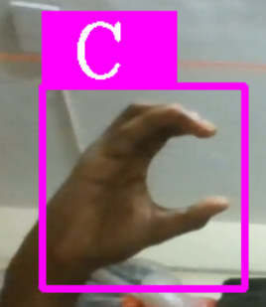
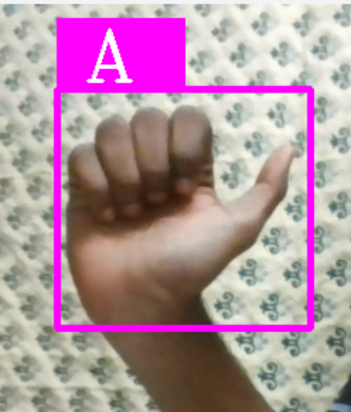
SCREENSHOT OF OUTPUT

Slide 14
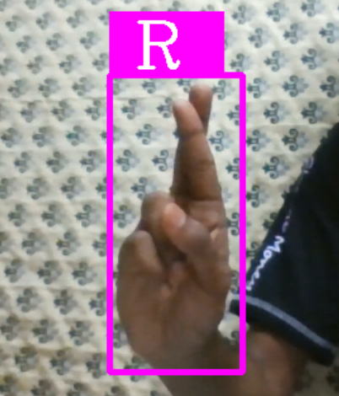
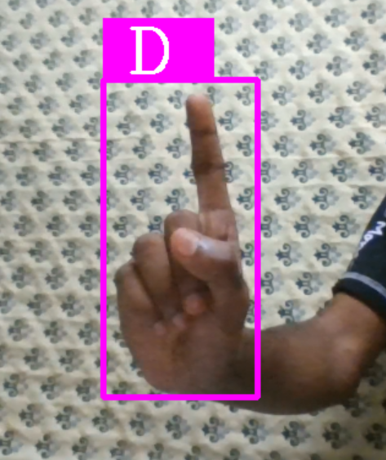

Slide 15
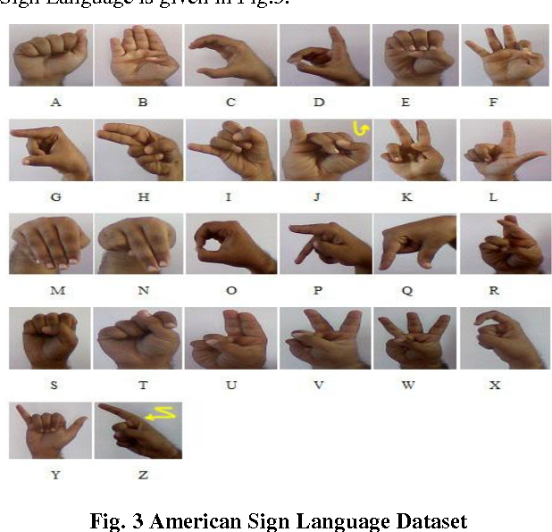

Slide 16
CONCLUSION
It involves the use of computer algorithms to interpret and classify hand movements and postures in real-time.
Our model is limited to recognise only the alphabets using the movements of our hand.We cannot the find the words or emotions using our model.
In our model we used CNN algorithm from teachable machine.
Teachable machines train the data with CNN and provides model and then model is imported into the code.
CNN is used because the accuracy is more in CNN when compared to other algorithms.
Our model helps to find the alphabets according to the symbols.

Slide 17
REFERENCES
Ross, A., & Nevatia, R. (1997). Real-time hand gesture recognition using neural networks. IEEE Transactions on Pattern Analysis and Machine Intelligence.
Bhuiyan, A. M. A., & Hossain, M. A. (2019). Hand gesture recognition using machine learning: A review. IEEE Access.
Varadharaj, G., & Raman, B. (2012). A survey of vision-based hand gesture recognition. Artificial Intelligence Review.
Teachable machine from Google https://teachablemachine.withgoogle.com/

Slide 18
THANK YOU

